Slide 1
A Quick Primer on TensorFrames Apache Spark and TensorFlow Together
Tom Drabas
Data Scientist II
Denny Lee
Principal Program Manager

Slide 2
Session Goals
What is Deep Learning?
A primer on feature learning
What is feature engineering?
What is TensorFlow?
Build a Deep Learning model to recognize objects in images
Introducing TensorFrames
TensorFrames – quick start

Slide 3
Tom Drabas Data Scientist II, Core Data Science (WDG)
All-around geek and nerd
Close to 15 years of industry experience: analytics, operations research and data science.
Worked in airlines, telecommunications, logistics and technology
Interested in big data, algorithms, neural networks, and… vintage electronics

Slide 4
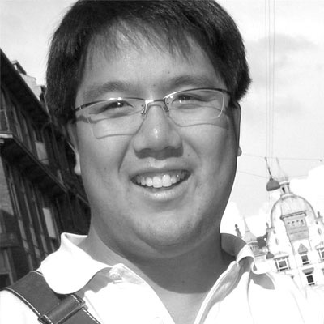
Denny Lee Principal Program Manager, Azure Cosmos DB
Former:
Technology Evangelist @ Databricks
Senior Director of Data Sciences Engineering at Concur (now part of SAP)
Principal Program Manager at Microsoft
Hands-on Data Engineer, Architect more than 15y developer internet-scale infrastructure for both on-premises and cloud including Bing’s Audience Insights, Yahoo’s 24TB SSAS cube, and Isotope Incubation Team (HDInsight).

Slide 5
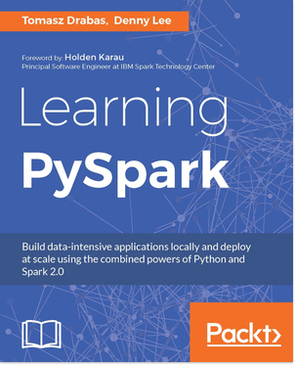
Jump Start into Python and Apache Spark

Slide 6
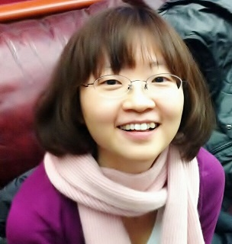
Many Thanks!
Tim Hunter
Software Engineer
Databricks
Joy Qiao,
Senior Solution Architect
Microsoft Algorithms and Data Science Solutions
Bilal Obeidat
Solution Architect
Databricks

Slide 7
Prerequisties

Slide 8
Tutorial Prerequisites
PySpark
As of Spark 2.2-ish, pip install pyspark
Databricks Community Edition
https://databricks.com/try-databricks

Slide 9

Get Databricks Community Edition
http://databricks.com/try-databricks

Slide 10
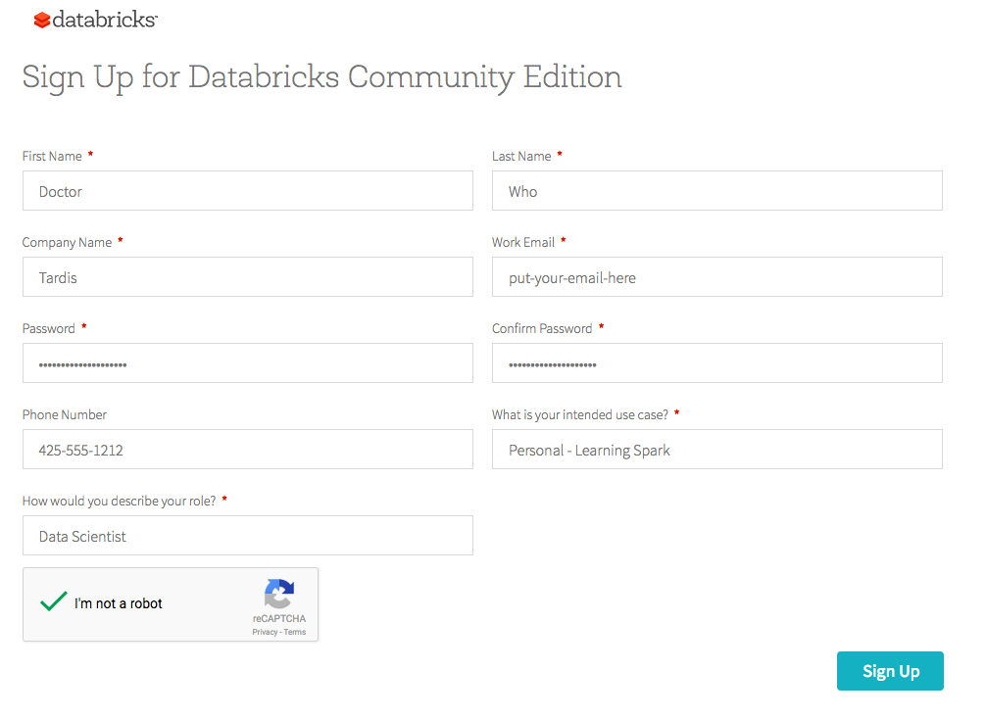
Sign Up for Databricks Community Edition

Slide 11

Confirm your email address

Slide 12

Sign in!
https://community.cloud.databricks.com

Slide 13
What are artificial neural networks?

Slide 14
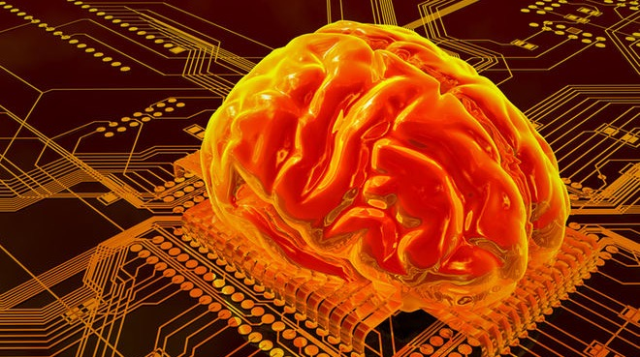
Artificial Neural Networks
source: http://bit.ly/2jjzFyt

Slide 15
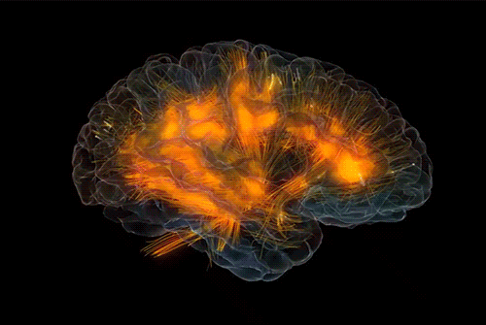
An imitation of human’s brain
Dense net of simple structures
Around 100 billion neurons
Each connected to ~10k other neurons
10¹⁵ synaptic connections
source: http://bit.ly/2jc9mYw

Slide 16
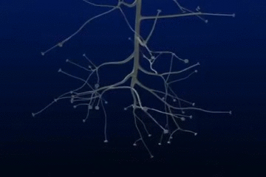
A neuron at work
Dendrites receive signals
Neuron’s cell body acts as an accumulator
If energy level in the neuron’s body exceeds certain level it fires a short pulse through the axon ended with synaptic terminals
source: http://bit.ly/2jjGlNd

Slide 17
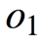
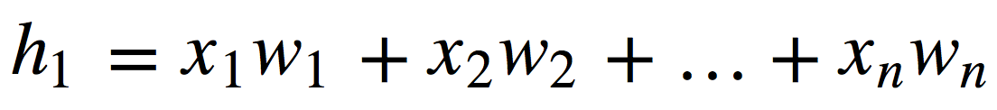
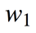
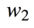
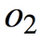
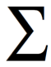
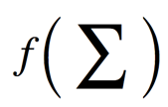
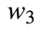
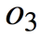
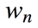
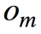
Conceptual mathematical model
Receives input from n sources
Computes weighted sum
Passes through an activation function
Sends the signal to m succeeding neurons

Slide 18
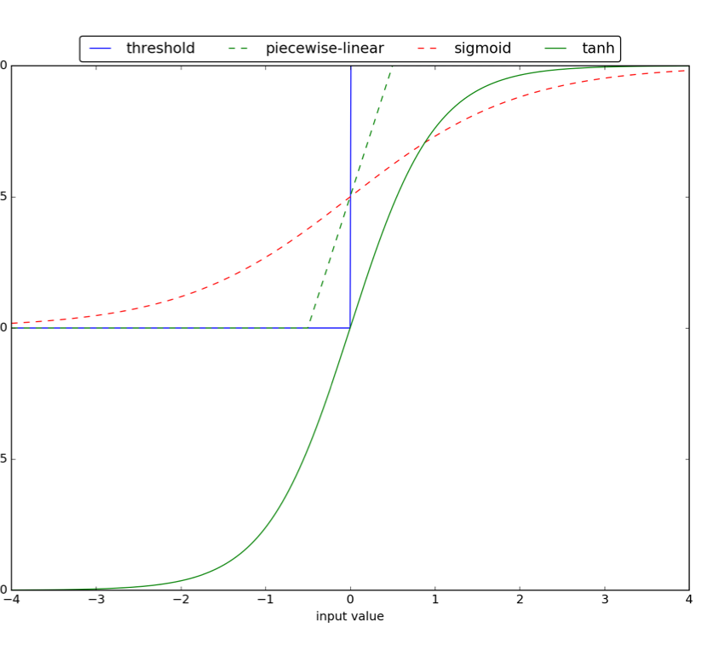
Activation functions
Bias (threshold) activation function was proposed first
Sigmoid and tanh introduce non-linearity with different codomains

Slide 19
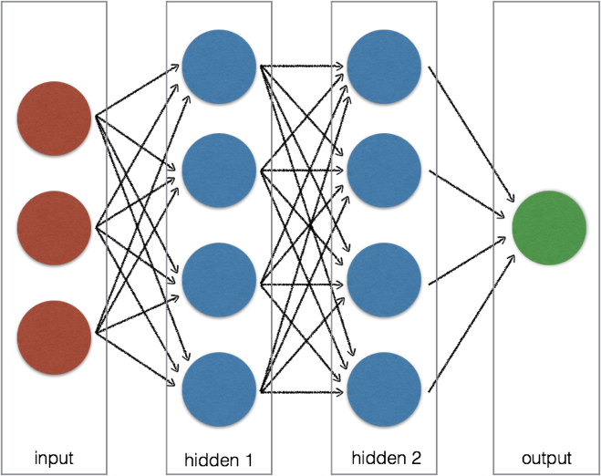
Artificial Neural Network
A layer is a set of neurons
Typically consists of input, hidden and output layers
Input layer acts as an interface
The neurons in hidden layer(s) and the output modify data
A black-box model

Slide 20
Types of neural networks
Image sources linked
Some examples
Single- or multi-layer
feedforward networks
Radial Basis Function
Recurrent Neural Networks

Slide 21
Learning
Image sources linked
Some examples
Backpropagation
Memory based learning
Self-organizing maps (competitive learning)

Slide 22
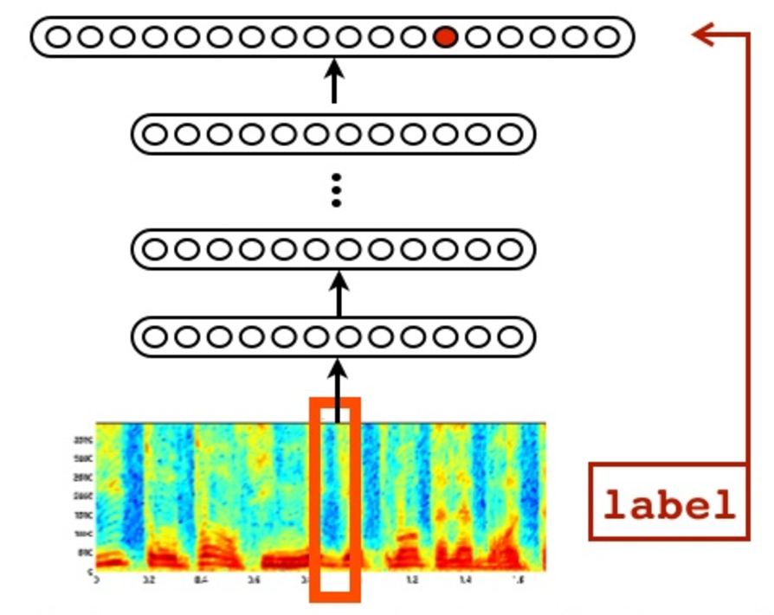
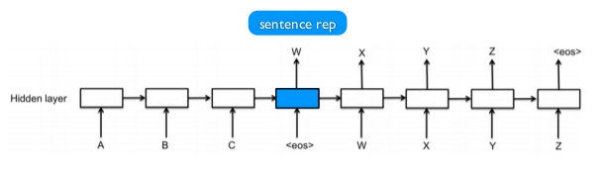
Applications of neural networks
Object Recognition: Facial
Game Playing
Object Recognition: Speech
Object Classification
Language Translation

Slide 23
What is Deep Learning?

Slide 24
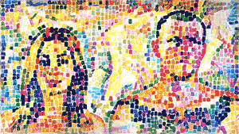
Deep Learning
source: http://bit.ly/2jcquh5
The next step in AI

Slide 25
Deep learning
Vast and sophisticated ANN structure
Tens, hundreds, thousands… of hidden layers
Ability to not only map the input to the output but recognize what inputs are needed for the task

Slide 26
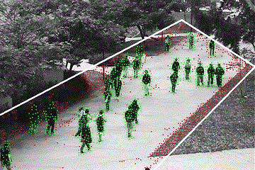
(Automated) Feature learning
Determine which features to use for a given task
Ability to (implicitly) perform feature transformations and dimensionality reduction
Automated feature engineering and learning eliminates the need for human intervention
source: http://bit.ly/2jwytoN

Slide 27
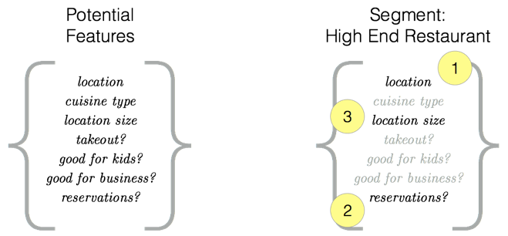
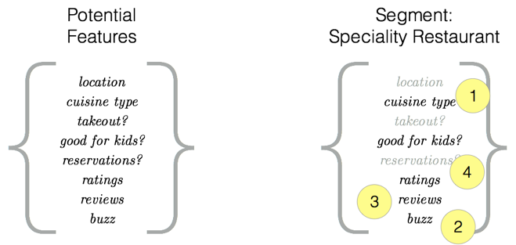
In practice
High-end restaurant
Key features are often related to location, ability to make reservations for large parties, and diversity of wine list
Specialty restaurant
Focus is on the reviews, ratings, social media buzz, and possibly if the restaurant is good for kids

Slide 28
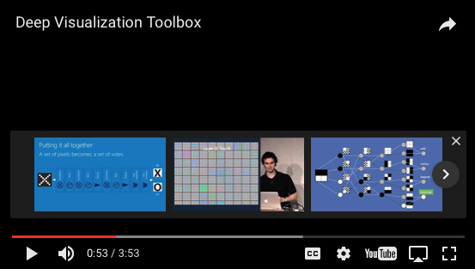
Deep Visualization Toolbox
Demonstrate different layers of the conv net neuron activation
https://github.com/yosinski/deep-visualization-toolbox

Slide 29

TensorFlow
source: http://bit.ly/2itbqJT
Technology from Google

Slide 30
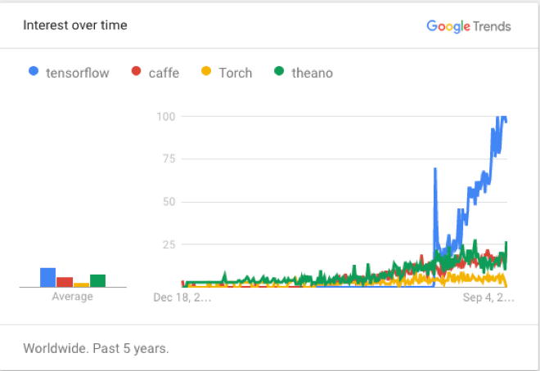
What is TensorFlow
Open source software library for numerical computation using data flow graphs
Based loosely on neural networks
Built in C++ with a Python interface
Quickly gained high popularity
Supports GPU computations

Slide 31
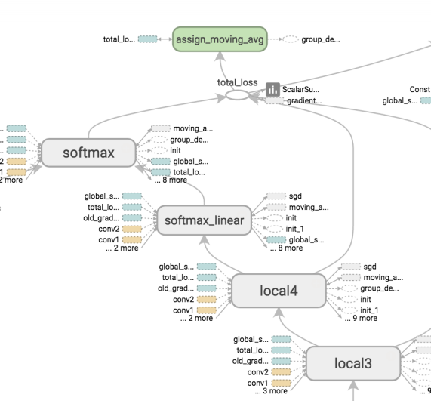
Data Flow Graph
Nodes represent mathematical operations
Edges are multidimensional arrays (tensors)
Thus, TensorFlow is a flow of multidimensional arrays (tensors) between the mathematical operations (nodes)
i.e. flow of tensors

Slide 32
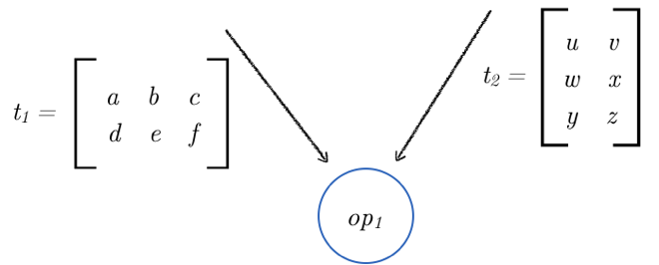
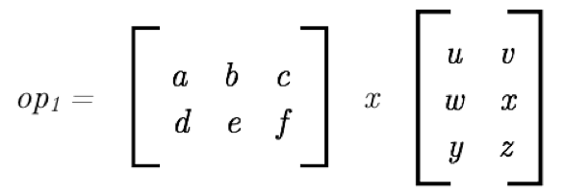
Concept
t1 is a 2x3 matrix
t2 is a 3x2 matrix
The op1 is a multiplication operator
The above can be represented in a matrix form
*

Slide 33
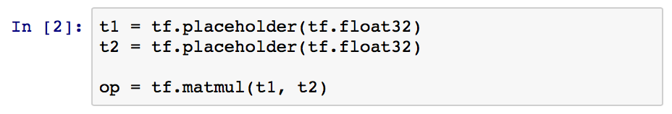
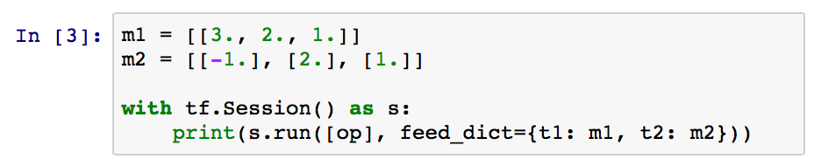
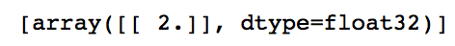
Example (pure Python)
Import TensorFlow
Prepare the tensors and operator
Feed the data
And get…

Slide 34
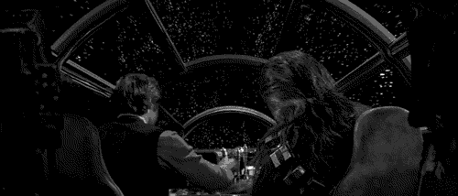
TensorFrames (experimental)
source: http://bit.ly/2jRN1mj
Built for speed!

Slide 35

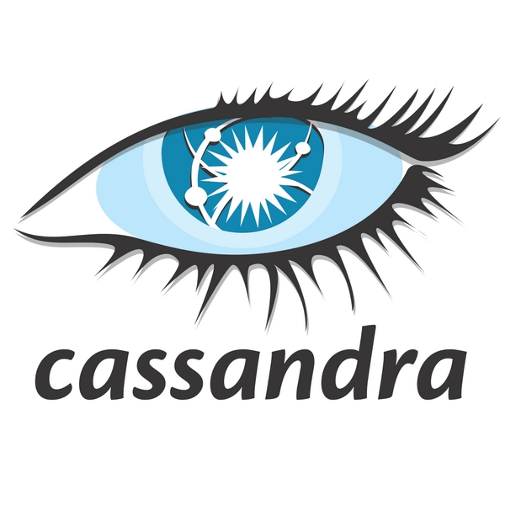



Apache Spark Engine
Spark SQL
Spark Streaming
MLlib
GraphX
Scale out, fault tolerant
Python, Java, Scala, and R APIs
Standard libraries
Spark Core
…
Unified engine across diverse workloads & environments

Slide 36



Spark to TensorFlow Communication Issues
Tungsten binary format
Java object
Python pickle
Python pickle
C++ buffer
Source: TensorFrames: Google TensorFlow with Apache Spark by Tim Hunter

Slide 37
TensorFrames: Native Embedding of TensorFlow
Tungsten binary format
Java object
C++ buffer
Spark worker process
Source: TensorFrames: Google TensorFlow with Apache Spark by Tim Hunter

Slide 38
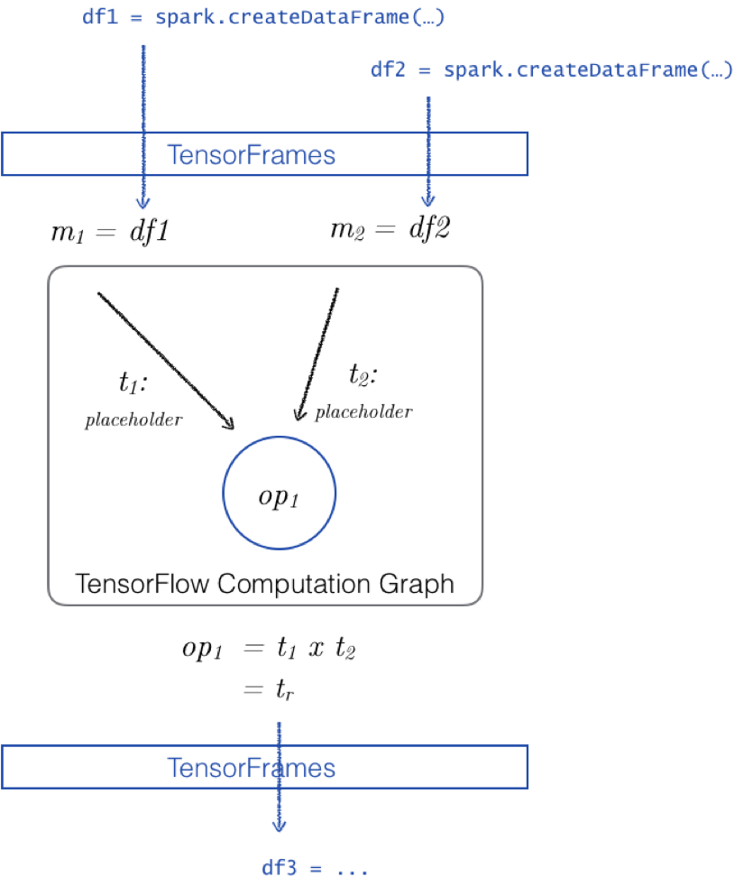
An intermediary
TensorFrames are built for speed*
Spark DataFrames as input
TensorFrames act as a bridge
Can return a DataFrame
http://bit.ly/2iVy8vm
Notes:
Massive speed ups reported http://bit.ly/2iVy8vm

Slide 39
Why TensorFrames?
Utilize TensorFlow with your data:
Allows data scientists to expand their analytics, streaming, graph, and ML capabilities to include Deep Learning via TensorFlow
Parallel training to determine optimal hyperparameters:
Determine optimal learning rate: If rate is high, it will learn quickly but may not take into account of high variability
Number of neurons in each layer: too many results in noisy estimates, too few and the network will not learn well.

Slide 40
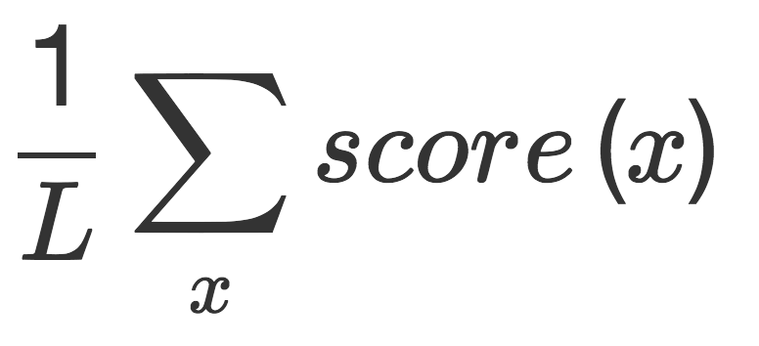
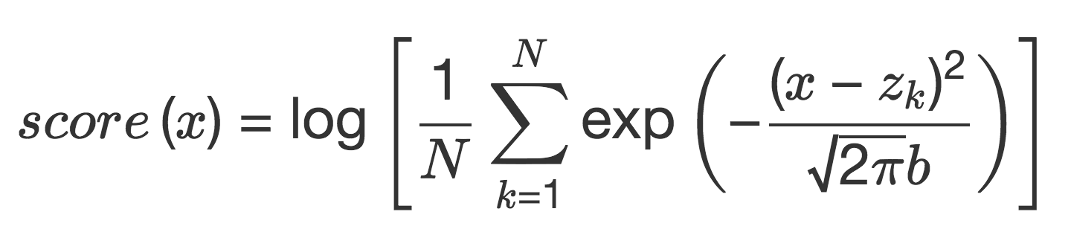
Comparing Kernel Density Scoring
Source: TensorFrames: Google TensorFlow with Apache Spark by Tim Hunter

Slide 41
Getting ready
From CLI run
$SPARK_HOME/bin/pyspark \
--packages databricks:tensorframes:0.2.8-s_2.11
or (preferred) in Free Community Edition on Databricks (instructions shortly)
Notes:
Once the above installed on Databricks detach and reattached your cluster

Slide 42
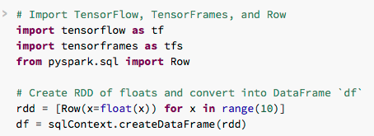
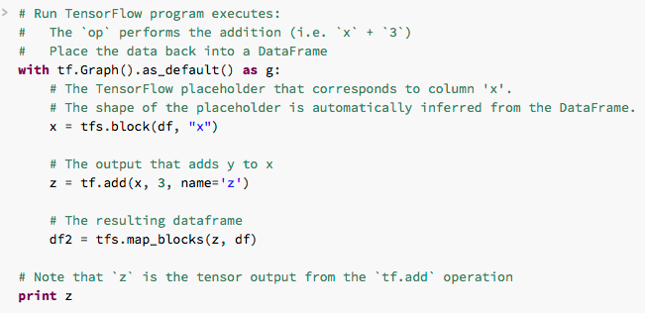
Start!
Import modules
Create some fake data
Create the graph
Block the variable
Add 3 to x and put in z
Return as df2

Slide 43
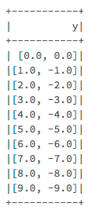
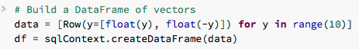
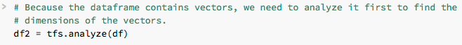
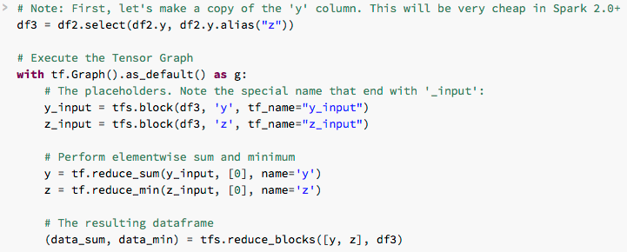
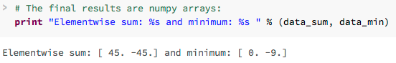
Element-wise sum and min
Create a DataFrame of lists
Analyze
Copy y
Create graph
Block the variables
Create the nodes
Get the results back

Slide 44
Tutorial Setup

Slide 45
Tutorial Prerequisites
Log into Databricks Community Edition (https://community.cloud.databricks.com)
Import notebooks: https://aka.ms/pydatatfs
Start cluster
Install libraries
Let’s go!

Slide 46
Import Notebooks
Steps to Import notebooks
Repeat

Slide 47
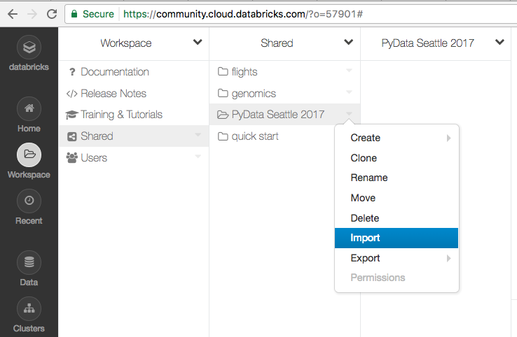
Import notebook

Slide 48
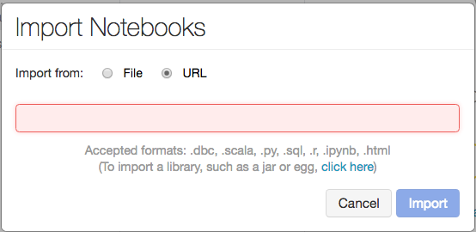
Import Notebook Dialog

Slide 49
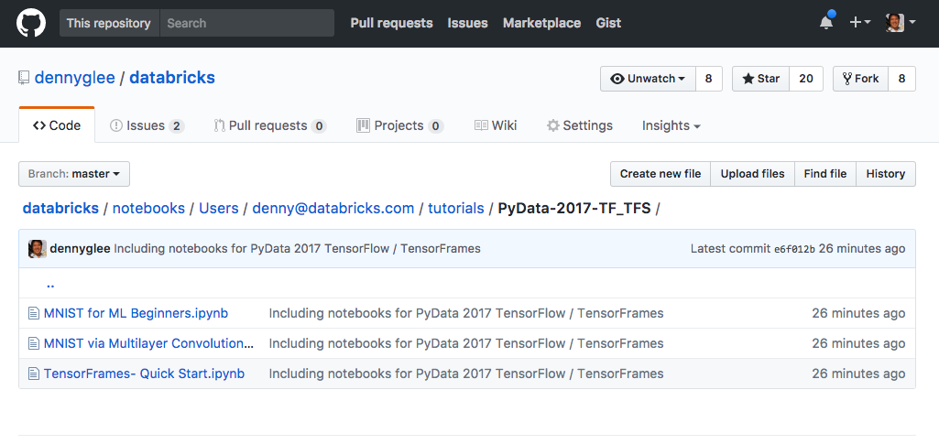
Goto https://aka.ms/pydata-sea-2017-tfs

Slide 50
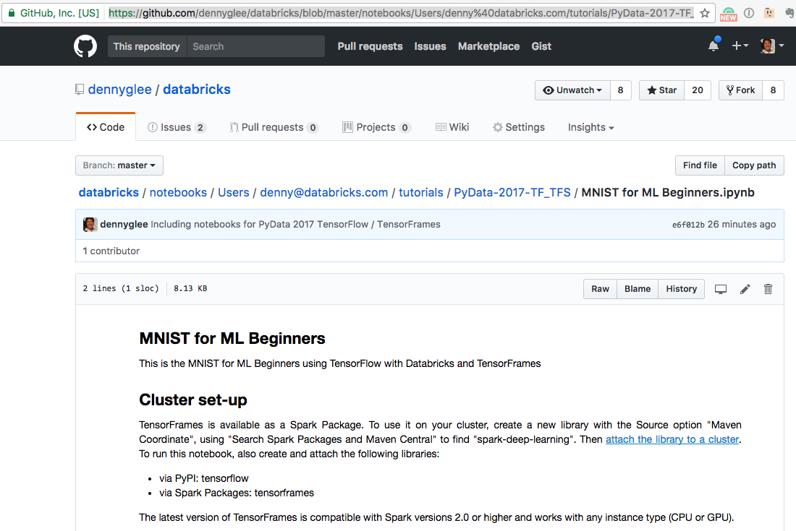
Open a notebook > Get URL

Slide 51

Paste URL into Import Notebooks dialog

Slide 52
Do it for all three notebooks

Slide 53
Start a cluster
Three steps to start a Spark cluster

Slide 54

Start a cluster
Clusters > Create Cluster
Fill in name and Run-time version: Spark 2.1 (Scala 2.11)

Slide 55
Install libraries
Installing TensorFlow via PyPi
Installing TensorFrames via Spark Packages

Slide 56

Create Library

Slide 57

Install TensorFlow via PyPi

Slide 58

Attach TensorFlow to your cluster

Slide 59

Install TensorFrames via Spark Packages

Slide 60

Find TensorFrames

Slide 61

Create TensorFrames Library … Almost!

Slide 62

Attach TensorFrames Library

Slide 63
Let’s go!

Slide 64
Handwritten Digit Recognition using Softmax

Slide 65
Softmax Function (Linear Classifier)
Source: http://bit.ly/2tNRZpg | Demo: http://stanford.io/2tJCtd7

Slide 66

CNN accuracy: ~92

Slide 67
ConvNetJS MNIST Demo
Andrej Karpathy’s MNIST Demo:
https://cs.stanford.edu/people/karpathy/convnetjs/demo/mnist.html

Slide 68
Handwritten Digit Recognition using CNNs

Slide 69

Handwritten Digit Recognition
Source: http://bit.ly/2sbFW0R

Slide 70
MNIST Data
Set of handwritten digits based on the National Institute of Science and Technology – i.e. a modified dataset or MNIST dataset – via LeCun et. al
Original source is NIST Special Database 19 Handprinted Forms and Characters Database comprised of:
Images: Each digit is a scanned 28px x 28px flattened into an array of size 784
Labels: One-Hot vector representing the actual number associated with the image

Slide 71
Great References
Andrej Karparthy’s ConvNetJS MNIST Demo
CS231n: Convolutional Neural Networks for Visual Recognition
Syllabus and Slides | Course Notes | YouTube
With particular focus on CS231n: Lecture 7: Convolution Neural Networks
Upcoming webinar: Build, Scale, and Deploy Deep Learning Pipelines with Ease

Slide 72

CNN Structure

Slide 73

CNN Structure
The Input layer is a grey scale image of 28x28
# Reshape to use within a CNN
x_image = tf.reshape(x, [-1, 28, 28, 1])
Image source: ConvNetJS MNIST demo

Slide 74
CNN Structure: Convolution Layer 1
Convolution layer 1 maps one grayscale image to
32 feature maps using 5x5 kernels using ReLU (rectifier) activation function
# First convolutional layer:
# maps one grayscale image to 32 feature maps.
W_conv1 = weight_variable([5, 5, 1, 32])
b_conv1 = bias_variable([32])
h_conv1 = tf.nn.relu(conv2d(x_image, W_conv1) + b_conv1)
Notes:
Having 32 feature maps gives better accuracy

Slide 75
CNN Structure: Convolution Layer 1
Convolution layer 1 maps one grayscale image to
32 feature maps using 5x5 kernels using ReLU (rectifier) activation function
Image source: ConvNetJS MNIST demo
Notes:
Having 32 feature maps gives better accuracy

Slide 76
Why normalize? (continued)
Normalization changes the range of pixel intensity
Also known as contrast stretching or histogram stretching
Bring image values to the same range
“If we don’t scale our input training vectors, the ranges of distribution of those feature vectors would likely be different for each vector – i.e. learning rate would cause corrections, e.g. over compensating one and under compensating another” [Source: http://bit.ly/2rsc2b1]

Slide 77

CNN Structure: Pooling 1
Pooling layer 1 down samples image by 2x
so you have a 14x14 matrix
# Pooling layer - downsamples by 2X.
h_pool1 = max_pool_2x2(h_conv1)
Image source: ConvNetJS MNIST demo

Slide 78

What’s happening here? (example)
CNN takes a square of patches of pixels (vs. individual pixels)
Filters them into a smaller square matrix AND equal to size of the patch (or kernel)
Job of filter is to find patterns in the pixels
Source: https://deeplearning4j.org/convolutionalnets.html

Slide 79
CNN Structure: Convolution 2
Convolution layer 2 maps 32
feature maps to 64 using ReLU (rectifier) activation function
# Second convolutional layer
# maps 32 feature maps to 64.
W_conv2 = weight_variable([5, 5, 32, 64])
b_conv2 = bias_variable([64])
h_conv2 = tf.nn.relu(conv2d(h_pool1, W_conv2) + b_conv2)

Slide 80

CNN Structure: Convolution 2
Convolution layer 2 maps 32
feature maps to 64 using ReLU (rectifier) activation function
Image source: ConvNetJS MNIST demo

Slide 81

CNN Structure: Pooling 2
Pooling layer 2 down samples by 2x
with 64 images of 7x7 (vs. 14x14)
Image source: ConvNetJS MNIST demo

Slide 82
CNN Structure: Fully connected feed-forward
# Fully connected layer 1
# after 2 round of downsampling, our 28x28 image
# is down to 7x7x64 feature maps
# -- maps this to 1024 features.
W_fc1 = weight_variable([7 * 7 * 64, 1024])
b_fc1 = bias_variable([1024])
h_pool2_flat = tf.reshape(h_pool2, [-1, 7*7*64])
h_fc1 = tf.nn.relu(tf.matmul(h_pool2_flat, W_fc1) + b_fc1)

Slide 83
CNN Structure: Dropout
# Dropout - controls the complexity of the model,
# prevents co-adaptation of features.
keep_prob = tf.placeholder(tf.float32)
h_fc1_drop = tf.nn.dropout(h_fc1, keep_prob)
# Map the 1024 features to 10 classes,
# one for each digit
W_fc2 = weight_variable([1024, 10])
b_fc2 = bias_variable([10])

Slide 84

CNN accuracy: ~98.95

Slide 85
Great References
Andrej Karparthy’s ConvNetJS MNIST Demo
What is back propagation in neural networks?
CS231n: Convolutional Neural Networks for Visual Recognition
Syllabus and Slides | Course Notes | YouTube
With particular focus on CS231n: Lecture 7: Convolution Neural Networks
Neural Networks and Deep Learning
TensorFlow

Slide 86
Great References
Deep Visualization Toolbox
Back Propagation with TensorFlow
TensorFrames: Google TensorFlow with Apache Spark
Integrating deep learning libraries with Apache Spark
Upcoming webinar: Build, Scale, and Deploy Deep Learning Pipelines with Ease

Slide 87
Q&A

